Slide 1

MSA PROJECT ML2
DEV TRIPATHI
PG-DSBA FEB21 G-12

Slide 2
Contents
Problem statement
About the dataset
Visualizations and Inferences
Association Rules and MBA Analysis
Results and Suggestions

Slide 3
Problem Statement
A Grocery Store have shared their transactional data with us. Our job is to identify the most popular combos that can be suggested to the Grocery Store chain after a thorough analysis of the most commonly occurring sets of items in the customer orders. Currently, the Store doesn’t have any combo offers.

Slide 4

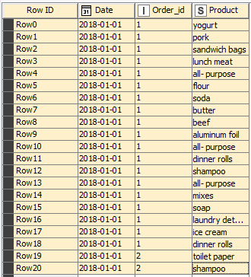
About the Dataset:
The dataset contains 3 columns and 20642 rows.
“Date” column is actually nothing but the order date of the product.
The data contains transactions happened between 01/01/2018 to 26/02/2020
“Order_id” is integer data type but since no aggregation can be applied on this id it should be treated as string value
“Order_id” can be treated as unique identification for each transaction.
The “Product” column is String datatype.
It contains total 37 unique values including products mentioned as ‘all-purpose’.
On the right we can see the top 20 rows of dataset.

Slide 5
Visualizations and Inferences

Slide 6
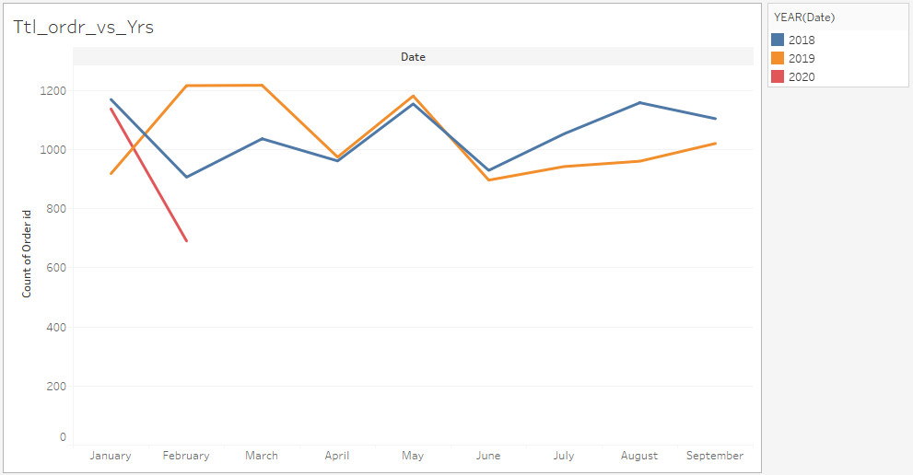
Total number of Orders over the years:
The total number of orders are decreasing from the last two years, mostly for first half of the year.
There is some seasonal component present in the data. For example number of orders go down in April then rise in may then again go down in June.
Note that there is no data available for 4th quarter of the year.

Slide 7
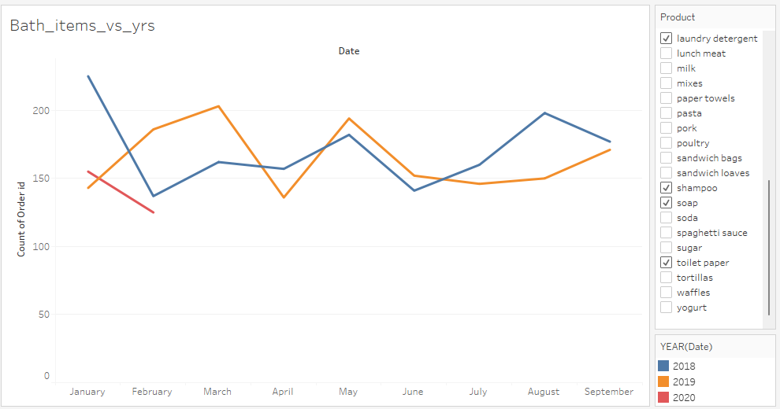
Total number of orders having the Bathroom and Laundry items over the years:
The number of orders for the bathroom and laundry items are pretty much the same.
Also, the total number of orders are also having seasonal component.
For example, from February till June both the line plots are following similar pattern.

Slide 8
Association Rules and MBA Analysis

Slide 9
What are Association Rules? Why we are using it for this study?
Association rules are basically set of if-then conditions which are generated from the associations and relationships present within a large sets of data items. While the concepts behind association rules can be traced back earlier, association rule mining was defined in the 1990s. These rules depict how frequently an itemset occurs in a transaction. A typical example is Market Based Analysis.
Association rules are very useful in pharma, retail, stock analysis, entertainment services, UI designing etc. For this particular study which is a retail problem the association rules can play decisive role.
Based on these association rules, the grocery store can increase their sales by introducing combos offers. Arrangement of products on different aisles can also be done based on the association rules found.

Slide 10
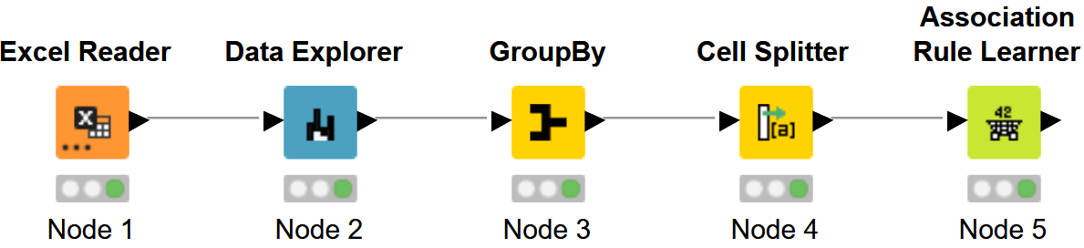
KNIME workflow for obtaining the association rules
Support and Confidence
Support threshold was found out to be 0.09 which means that among the 1139 orders, minimum 9% orders must have the itemset present in the data. Confidence threshold was set to be 0.5 because for most of the itemset and product associations, the values were very close it. Confidence value simply tells the conditional probability of an item being chosen given that an itemset has already been picked from the list of products.

Slide 11
Sample of Association Rules
The rules are sorted in descending order of lift, which basically tells us how many folds the probability of putting the “consequent” in the basket has increased given that “items” were already present in the basket.

Slide 12
Results and Suggestions

Slide 13
Based on this analysis, here we have suggested some products which can be put as combos or bundles for getting more “lift” in sales of the products.
Itemset | Product
Spaghetti sauce, poultry | Dinner rolls
Poultry, Aluminum foil | Juice
Eggs, Soap | Soda
Dinner rolls, Soda | Eggs
Dishwashing liquid/detergent, Poultry | Mixes
Note: As it can be observed from the “lift” values in the previous slide, the lift values are not very promising. Hence, the sales of the products won’t go up by a huge amount but somewhat increase can be observed for sure if these combos and bundled are provided.

Slide 14
Tools used in this analysis
KNIME was used getting the association rules.
Tableau was used for the visualization purposes. The supporting file can be viewed from the link: https://public.tableau.com/app/profile/dev.tripathi/viz/Dev_Market_Basket_ML2/Bath_items_vs_yrs
Excel was used for table creation and pasting the reults data from KNIME.

Slide 15
Thank you!

